Slide 1
Wardrobe App
CS 3200 - Database Design
Professor Durant
By Raymond You and Elizabeth Cho

Slide 2

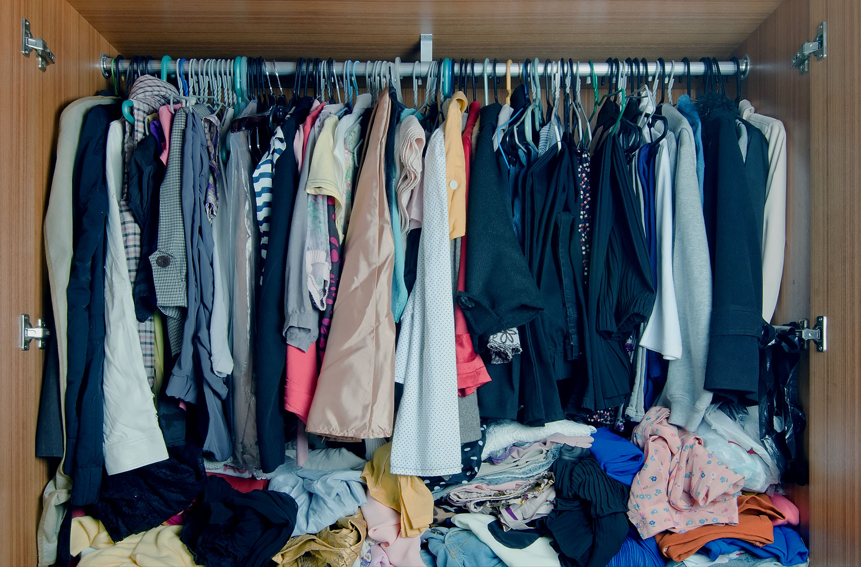

Motivation

Slide 3



Technology

Slide 4
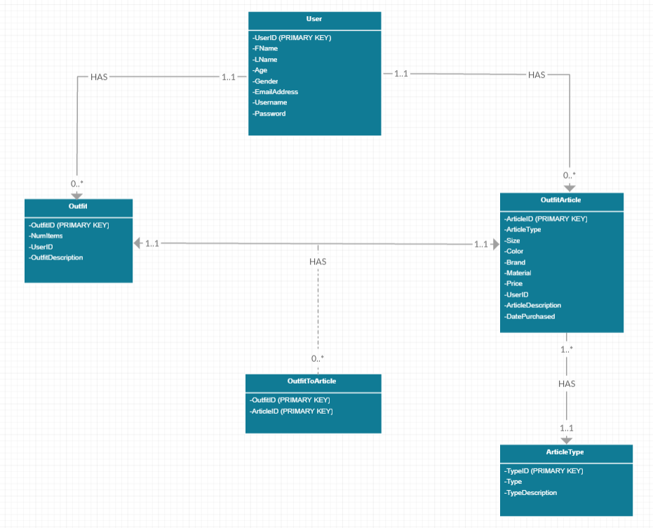
UML Diagram

Slide 5
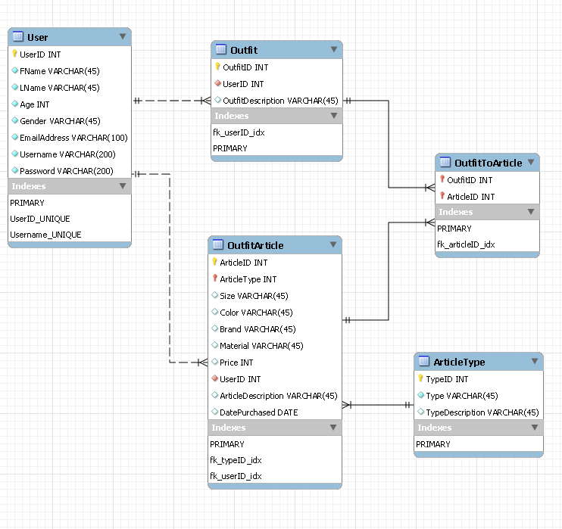
EER Diagram

Slide 6
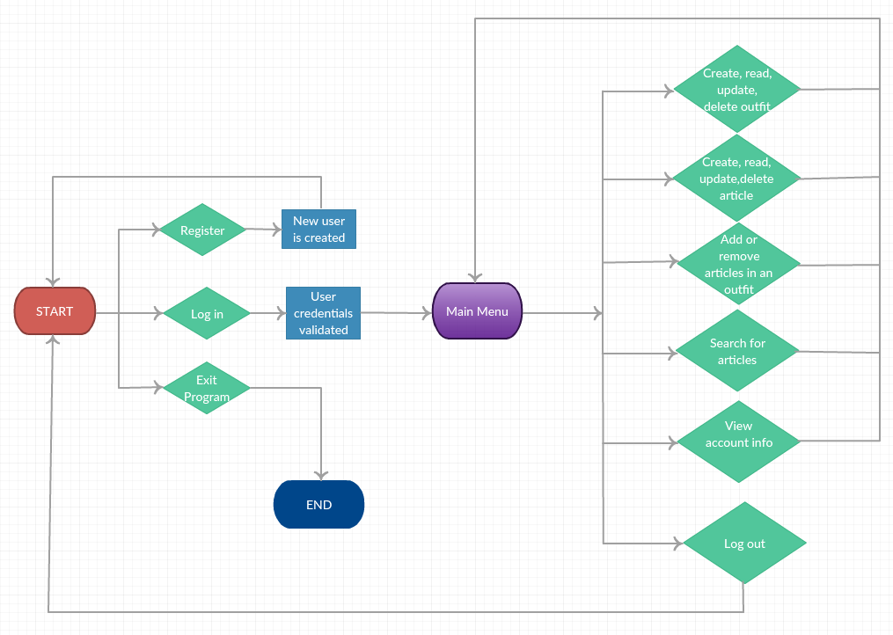
Flow Chart

Slide 7
Demonstration!

